Slide 1
Pablo Picasso
Student’s Name
Institutional Affiliations
Course Title
Instructors Name
Date

Slide 2
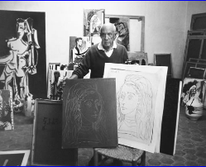
Who is Pablo Picasso
Pablo Picasso was a Spanish painter born in October 1881.
He was one of the greatest influential artists of the 20th century and creator of Cubism.
Picasso devoted himself to an artistic production that contributed significantly to and paralleled the whole development of modern art in the 20th century.
Pablo Picasso was the son of José Ruiz Blasco, a professor of drawing and Maria Picasso López.
Notes:
His unusual adeptness for drawing began to manifest itself early, around the age of 10.
when he became his father’s pupil in A Coruña where the family moved in 1891.
From that point his ability to experiment with what he learned and to develop new expressive means quickly allowed him to surpass his father’s abilities

Slide 3
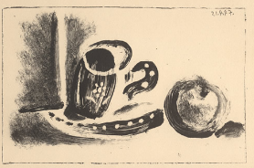
Techniques Pablo Picasso used
Picasso is known for using Engraving, drypoint, etching, and aquatint are intaglio forms of printmaking.
Picasso is known for having extended the boundaries and traditional means of the printmaking techniques.
Some of Picasso's prints were printed on smaller margined papers, and others on larger paper and therefore wider margins.
Notes:
The engraving technique had been used for centuries to reproduce drawings and paintings, a way to allow more people to own or see the works of art by artists who would otherwise only have the original without the possibility of additional "copies" of the unique image.
A drypoint was made by scratching a sharp needle into a metal plate, raising tiny ridges that also catch ink.
In etching, a metal plate is covered with an acid-resistant ground, usually, varnish, through which the image is drawn with a pointed tool, exposing the metal below. Aquatint was invented in the 18th century as a variation on etching, which Picasso mastered in 1936.
The technique are shown below and often combined techniques in producing his original graphics.

Slide 4
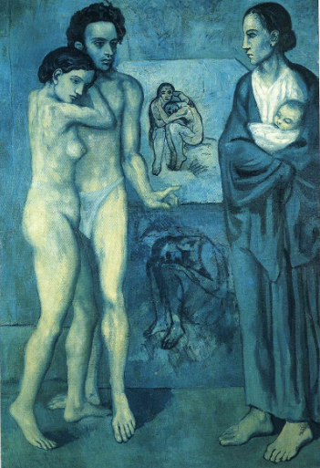
Blue period in Pablo Picasso life
Between 1901 and mid-1904, when blue was the predominant color in his paintings, Picasso moved back and forth between Barcelona and Paris, taking material for his work from one place to the other (Muniz, etal,2014).
The subject of maternity also preoccupied Picasso when he was searching for material that would best express traditional art-historical subjects in 20th-century terms.
Notes:
For example, his visits to the Women’s Prison of Saint-Lazare in Paris in 1901–02, which provided him with free models.
It offered a compelling subject matter, which was reflected in his depictions of Barcelona street people—blind or lonely beggars and castaways in 1902 to 03.
The subject matter of women were allowed to keep nursing children with them at the prison.

Slide 5
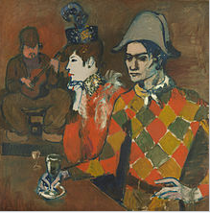
Rose period
The Rose period lasted from 1904 to 1906.
The shades of pink and rose-filled Picasso's art with a hot, unintentional atmosphere over his Blue Period paintings.
one of his best-selling works during the Rose Period, Pipe Boy.
There was an elements of primitivism in the Rose Period
Notes:
Harlequins, clowns and circus people are some of the recurring themes in these works of art.
Rose Period paintings show an examination of Picasso's art style.
The shades of pink and rose-filled Picasso's art with a hot, unintentional atmosphere over his Blue Period paintings

Slide 6
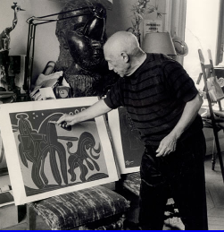
Pablo Picasso's style of Artwork
Analytic cubism (1909–1912) is a painting style Picasso developed with Georges Braque using monochrome brownish and neutral colors.
Between 1915 and 1917, Picasso began a series of paintings depicting highly geometric and minimalist Cubist objects.
It consisted of either a pipe, a guitar or a glass, with an occasional collage element..
Notes:
Both artists took apart objects and "analyzed" them in terms of their shapes.
Picasso may have produced little gems in response to critics who had claimed his defection from the movement,.
through his experimentation with classicism within the so-called return to order following the war

Slide 7
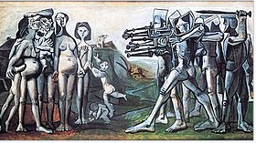
Pablo Picasso most famous piece
"Guernica" is not only Picasso's best-known work, but it's also one of the most famous (and Google-searched) paintings in the world.
Its depiction of an aerial bombing raid on Guernica's Basque town in April 1937, during the Spanish Civil War, was an visual prelude to the coming atrocities of World War II (d'Souza, 2012).
With his bold shapes and characteristic angles, the Spanish artist captured everything from the horrors of war to the boundless possibilities of the human form.
Notes:
The muted tones of gray further emphasize the shapes of humans
Their arms were outstretched in agony, and paint the documentary-style impact of a black-and-white photograph.
It also contains animal imagery heavily associated with Spain, namely the bull and the horse.

Slide 8
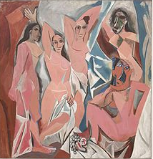
African Influence
During his time of African art and Primitivism from 1907 to 1909, Picasso made one of his most famous and controversial works of art.
Inspired by the angular African art, he watched at the Palais de Trocadero exhibition (Swami, 2013)
African masquerade hosted by Henri Matisse Picasso's art showed these influences during this time.
Notes:
Ironically, Matisse was one of the most vocal persecutors when Picasso first showed him his inner circle
Picasso made one of his controversial artwork.
African masquerade hosted by Henri Matisse Picasso's art showed these influences during this time.

Slide 9
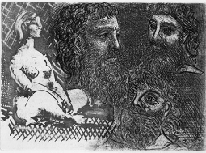
Neo-classism in Picasso paintings
The Picasso art period extending from 1919 to 1929 featured a significant shift in style (McNeese, 2006).
During the 1930s, Picasso's works such as his well-known Guernica a unique depiction of the Spanish Civil War.
It reflected the violence of war time.
Notes:
In the wake of his first visit to Italy and the conclusion of World War I,.
There was artist's paintings, such as the watercolor Peasants Sleeping (1919).
The menacing minotaur became a central symbol of his art, replacing the harlequin of his earlier years.

Slide 10
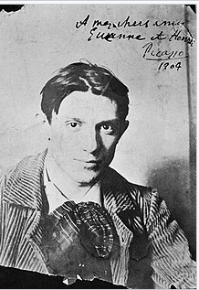
Picasso move to France
He bestowed on his son a talent for applying oil on canvas.
Picasso had to go elsewhere to develop his singular sense of Modernist innovation (Brink, 2007).
After spending his teen years in Barcelona and Madrid,, he moved to Paris for good 1904.
Notes:
Picasso bestowed his skills on his son who developed skills on applying oil on canvas
Picasso later became the modernist innovation
In 1904 he moved to paris to developed his career.

Slide 11
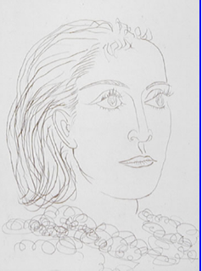
Picasso's Influence on Art
Pablo Picasso often mixed various styles to create the perfect interpretation of what he saw.
He was an influential figure in Cubism development and raised the college to the level of fine art (Swami, 2013).
Picasso followed his vision as he led him to new art forms.
From a public point of view, he has long been the epitome of ingenuity in modern art.
Notes:
Picasso constant search for love in his many romantic connections throughout his life motivated him to create countless paintings, sculptures and paintings.
As one of the significant influences on the 20th-century artistic movement, Picasso is not just a man and his work. Picasso is always a myth.
With courage and confidence that could not be thwarted by a meeting or by fear of being ostracized,
Picasso is an idol, one of those rare creatures that serve as a cross to focus on the various and often unorthodox events of the culture, which seem to form the artistic life of their age in one person.

Slide 12
References
Muniz Jr, A. M., Norris, T., & Fine, G. A. (2014). Marketing artistic careers: Pablo Picasso as brand manager. European Journal of Marketing.
Brink, A. (2007). Desire and Avoidance in Art: Pablo Picasso, Hans Bellmer, Balthus and Joseph Cornell: Psychobiographical Studies with Attachment Theory. Peter Lang.
McNeese, T. (2006). Pablo Picasso. Infobase Publishing.
d'Souza, A. (2012). Biography becomes form: William Rubin, Pablo Picasso, and the subject of art history. Word & Image, 18(3), 126-136.
Swami, V. (2013). Context matters: Investigating the impact of contextual information on aesthetic appreciation of paintings by Max Ernst and Pablo Picasso. Psychology of Aesthetics, Creativity, and the Arts, 7(3), 285.

